Slide 1

Increasing Efficiency of Banking Marketing
A supervised machine learning project
By Gustav Malmer

Slide 2
The Challenge

Slide 3
The Challenge
200

Slide 4
The Challenge
200 $

Slide 5
The Challenge
11 %

Slide 6
Agenda
Approach
Dataset
Feature Engineering
Model and Performance
Conclusion and Business Implications

Slide 7
Approach
Supervised learning
Baseline - Cannot look to accuracy (86% benchmark) - Business value in capturing potential customers
Want to optimize for precision and recall

Slide 8
Dataset
Three types of columns - Customer info (age, marital status, education, job…) - Action info (prior contacts, campaigns…) - Makroeconomic factors (CPI, Euribor, consumer, consumer confidence index…)
Dependent variable: y = signed up?

Slide 9
Dataset
Three types of columns - Customer info (age, marital status, education, job…) - Action info (prior contacts, campaigns…) - Makroeconomic factors (CPI, Euribor, consumer, consumer confidence index…)
Dependent variable: y = signed up?

Slide 10
Features:

Slide 11
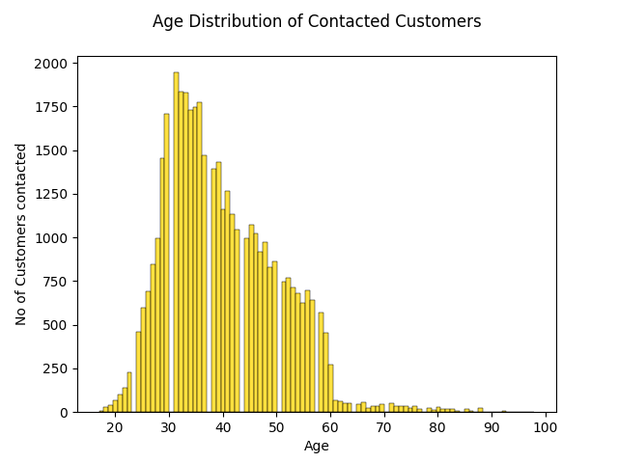

Slide 12
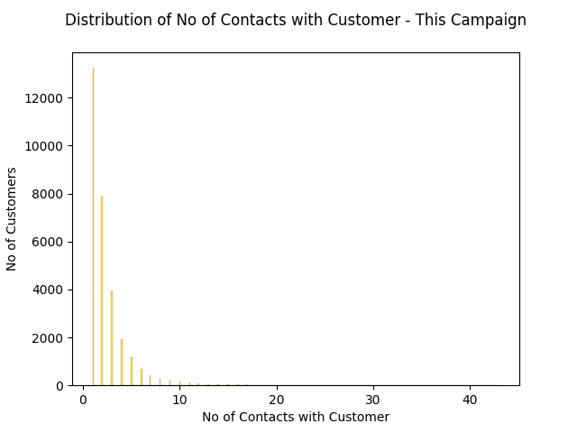

Slide 13
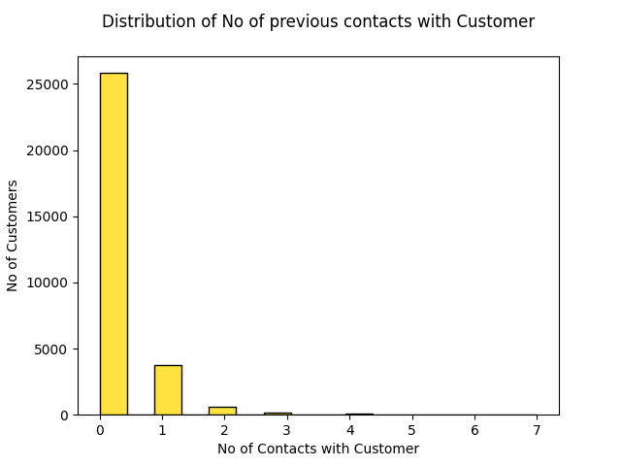

Slide 14
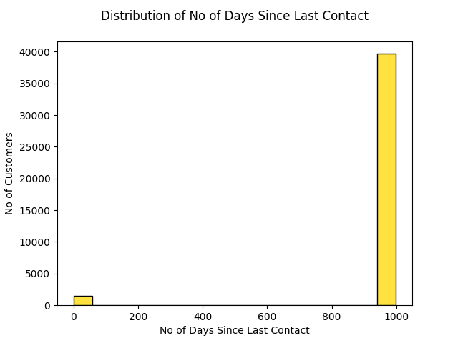

Slide 15
Feature Engineering and Preprocessing
Standardizing (StandardScaler)
Dummy variables (OneHotEncoder)
One column created: prior_contact
Two columns dropped: duration and pdays
Data cleaning

Slide 16
Model

Slide 17
Model Selection:
Tested four classification models: - KNN - Random Forest - SVC - Logistic Regression
Hyperparameter tuning for three
Optimal model

Slide 18
 | Random Forest | SVC | KNN | LogReg
Accuracy | 0.881 | 0.890 | 0.879 | 0.890
 | Random Forest | SVC | LogReg
Recall | 0.300 | 0.276 | 0.250
Optimal parameters | Max_depth = 70 N_estimators = 50 | C = 10 Gamma = ’scale’ | C = 10 Solver = ’liblinear’

Slide 19
Performance

Slide 20
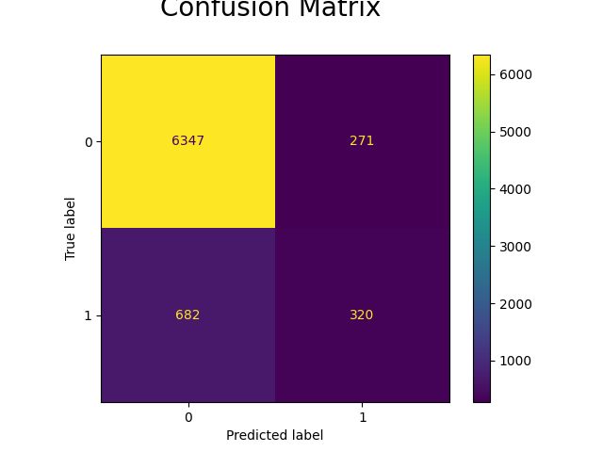
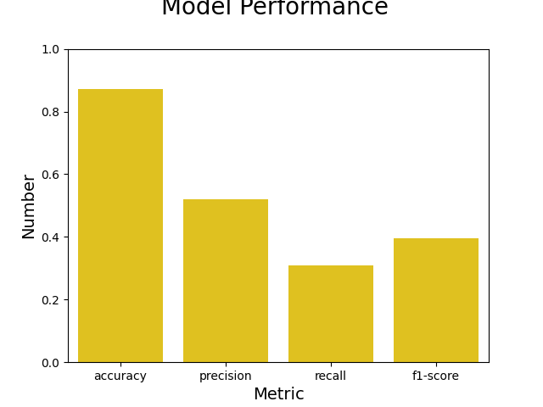
F1-score | Recall (share of potential customers id:d) | Precision (share of identified customers correct) | Accuracy (share of people correctly id:d)
0.395 | 0.309 | 0.519 | 0.872

Slide 21

Business Implications
Assuming a salary cost: 4000 $
Means 20 acquired customers
Given 10% conversion
Value of precision = 52 %?
Recall important as well

Slide 22
The Outcome
5 X

Slide 23
